Slide 1
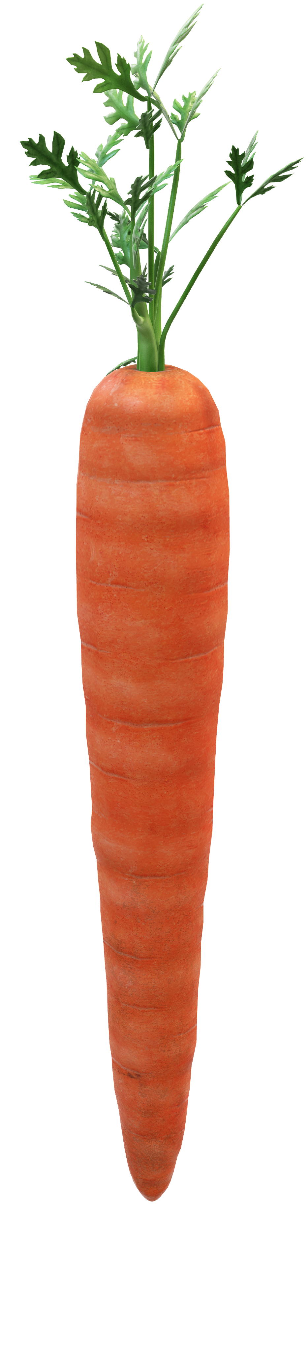
REC
RECIPEZ
What can you do with a carrot?
Cook with
what you have.

Slide 2
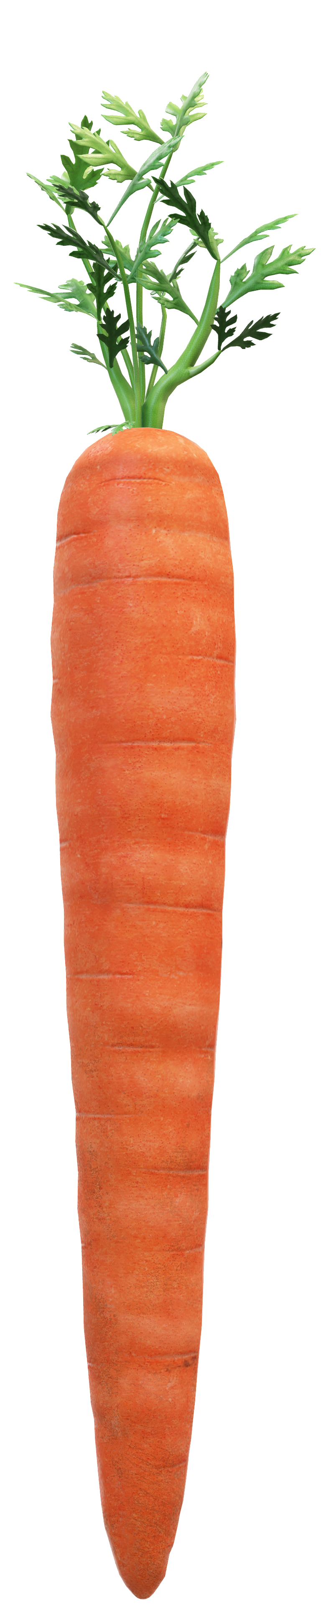
PROBLEM
REC
RECIPEZ
Cook with
what you have.

Slide 3
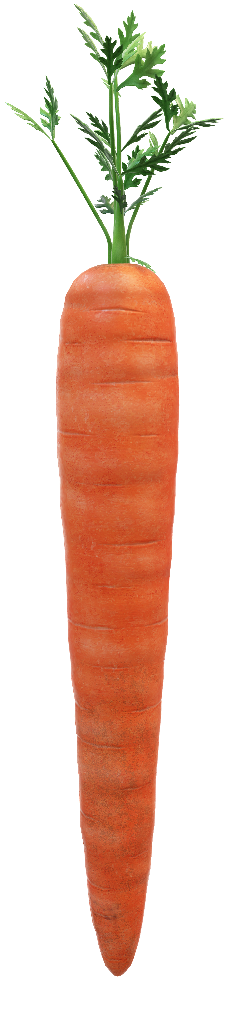
PROBLEM
RECIPEZ
RECIPEZ
47%
42%
Add groceries into virtual fridge
Millennials Incapable of Cooking¹
Groceries disposed from fridge²
Input your filter options
Recipes with your groceries!
Cook with
what YOU have.
Notes:
Roots of the problem

Slide 4

SOLUTION
RECIPEZ
Add groceries into virtual fridge
Input your filter options
Recipes with your groceries!
Notes:
Roots of the problem

Slide 5
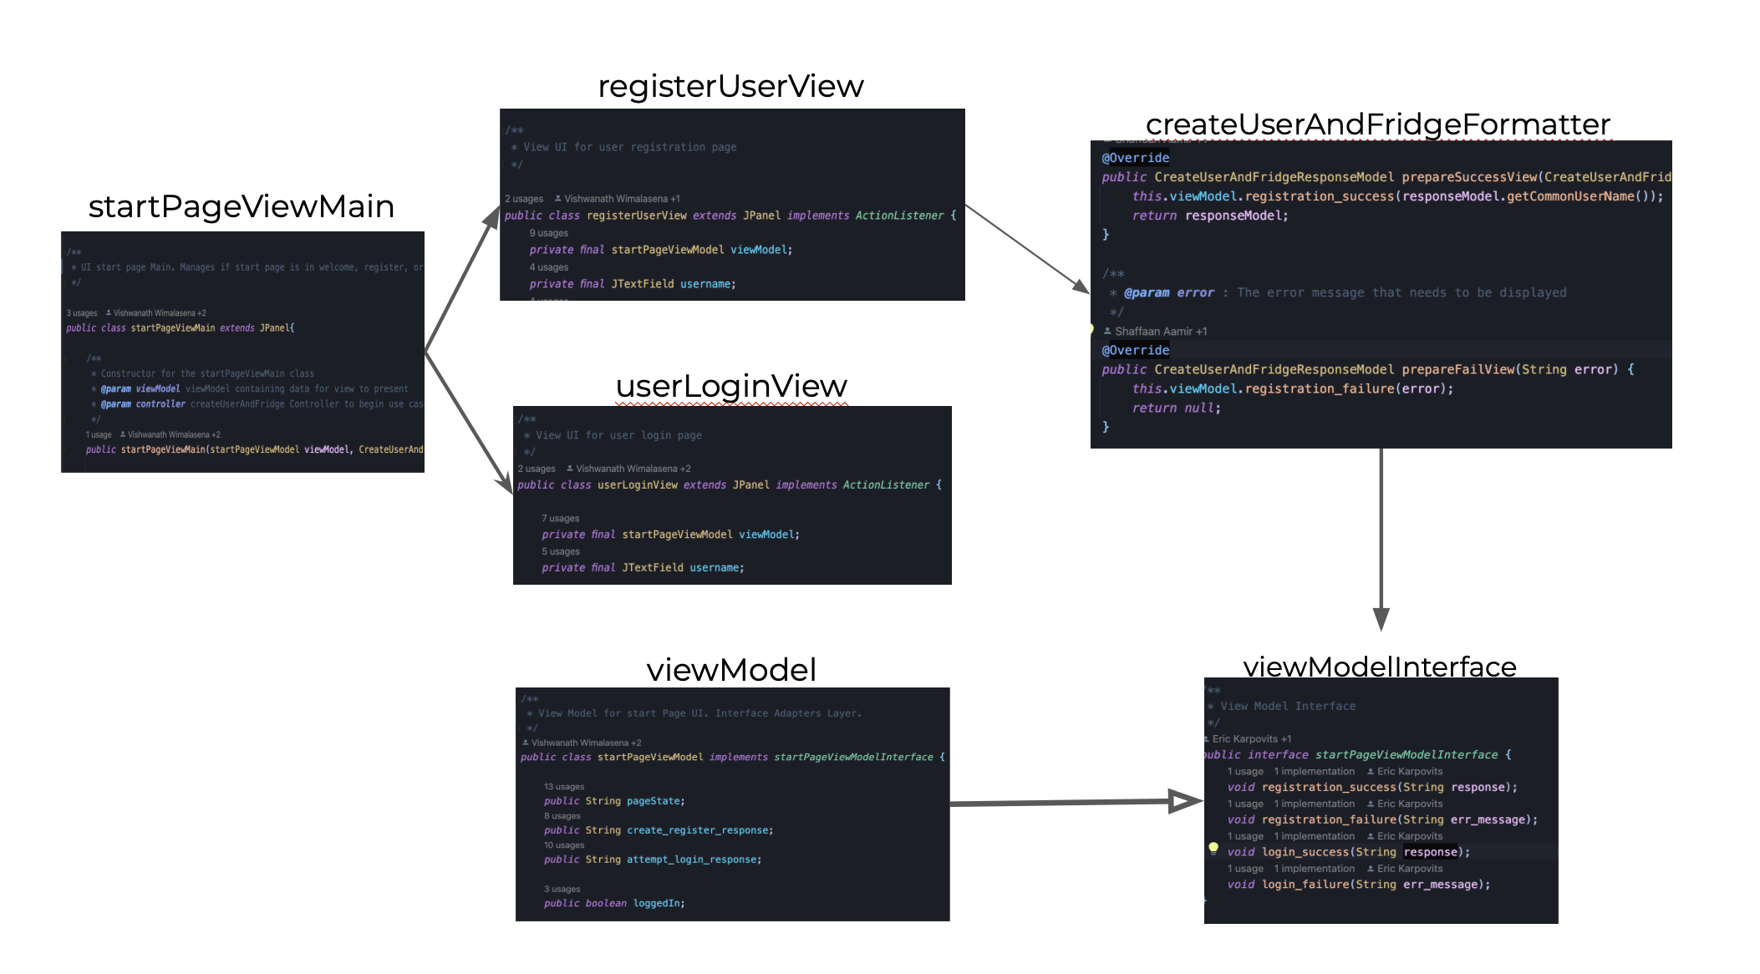
Start Page

Slide 6
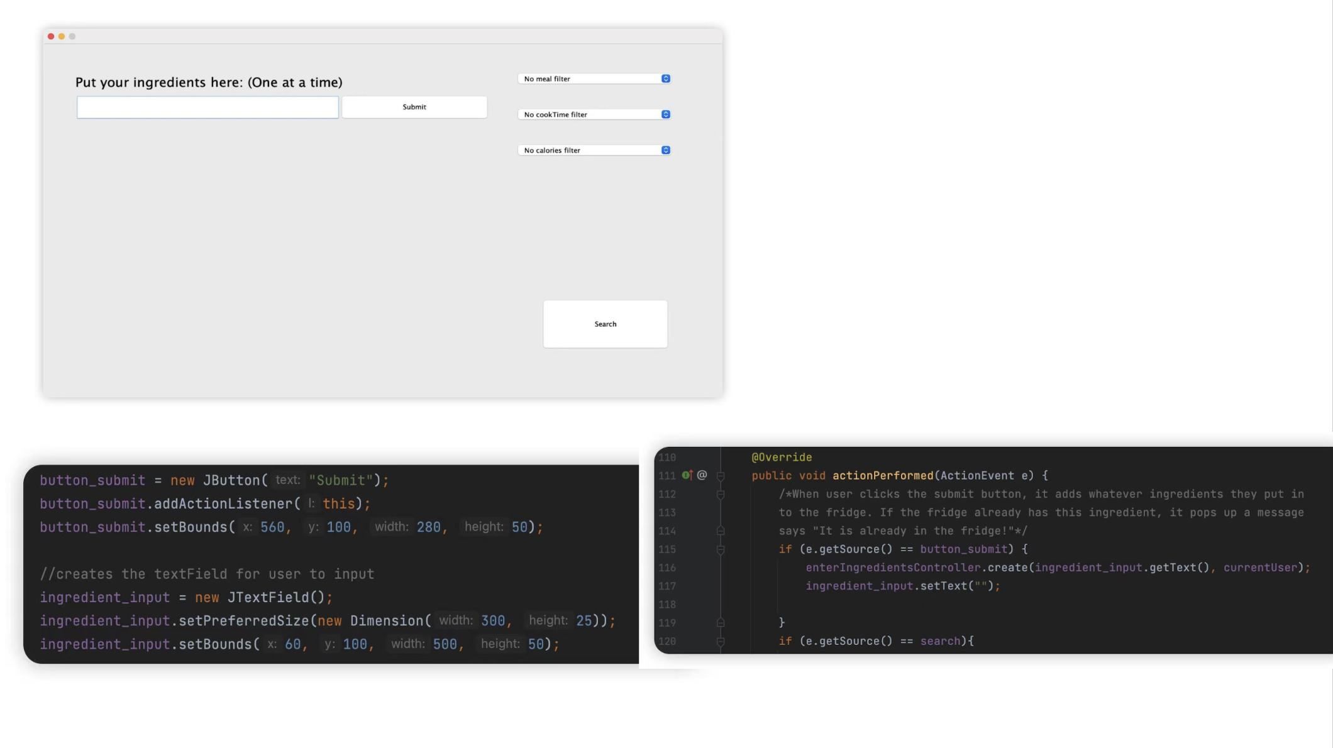
Search Page
Notes:
Swing does not update the view automatically,

Slide 7
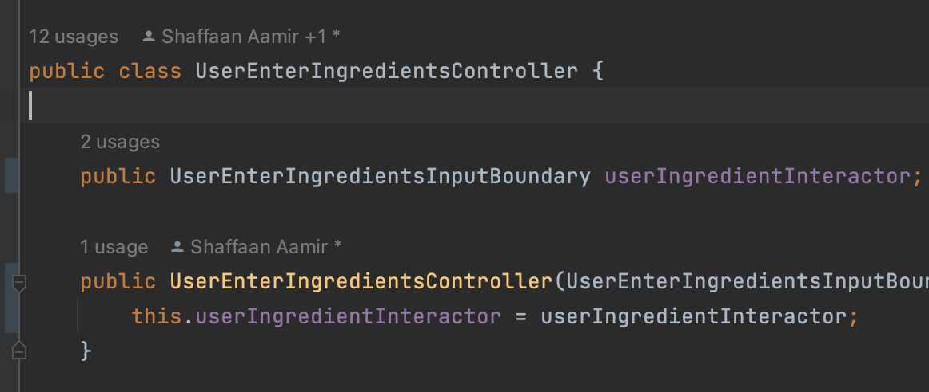
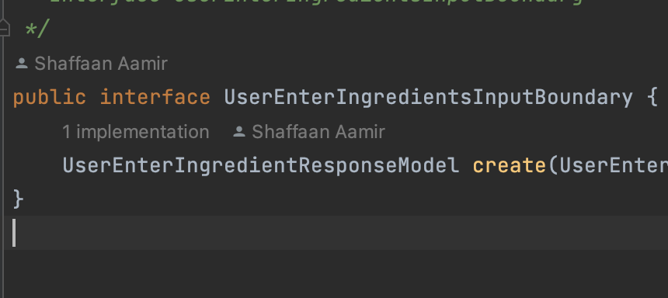
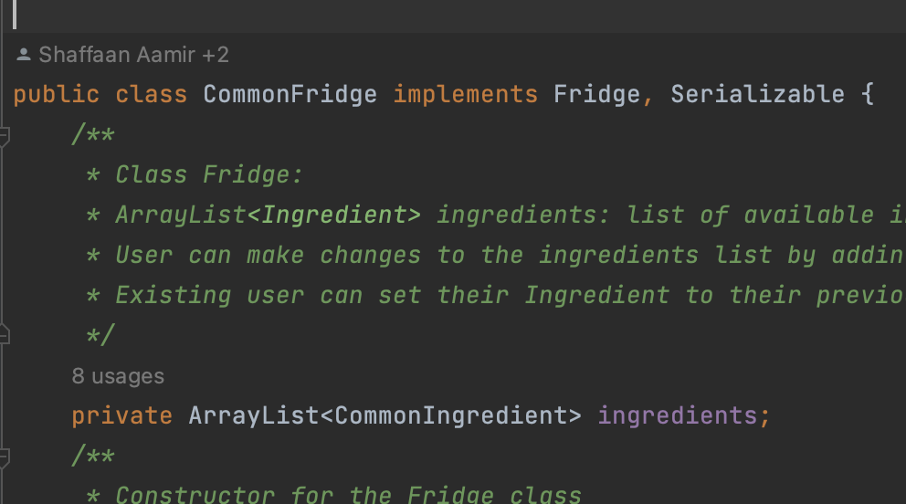
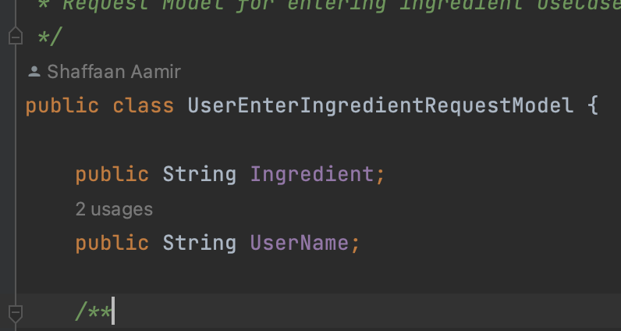
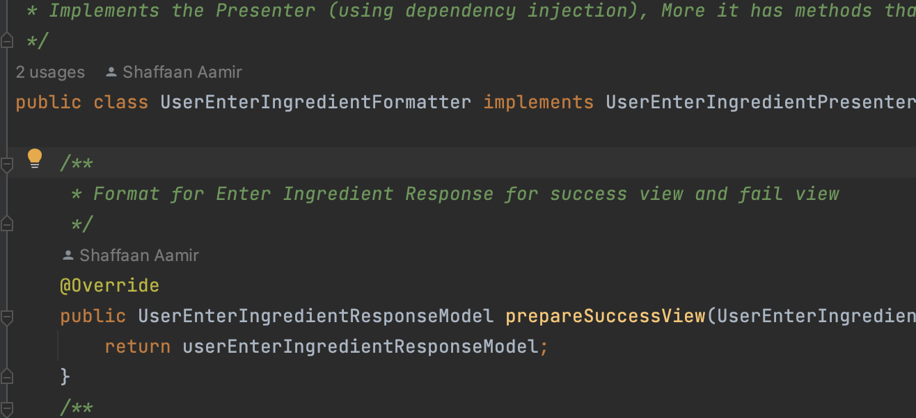
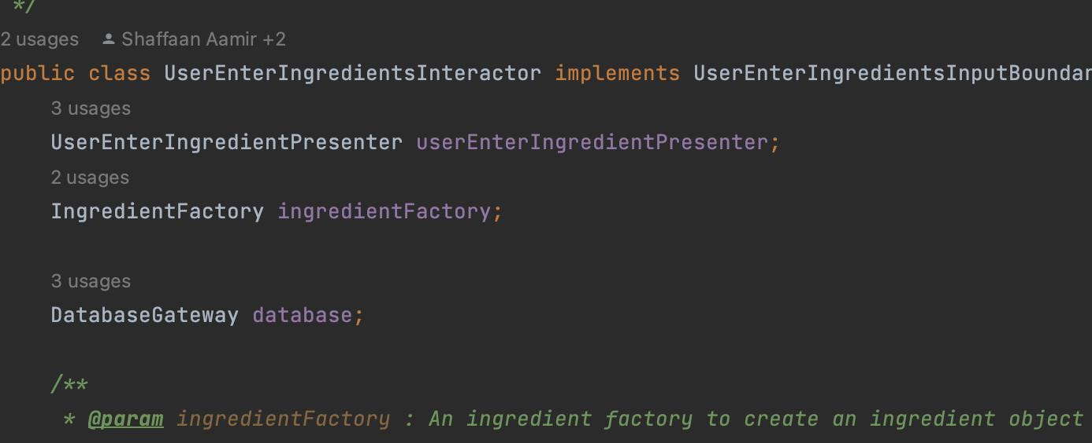
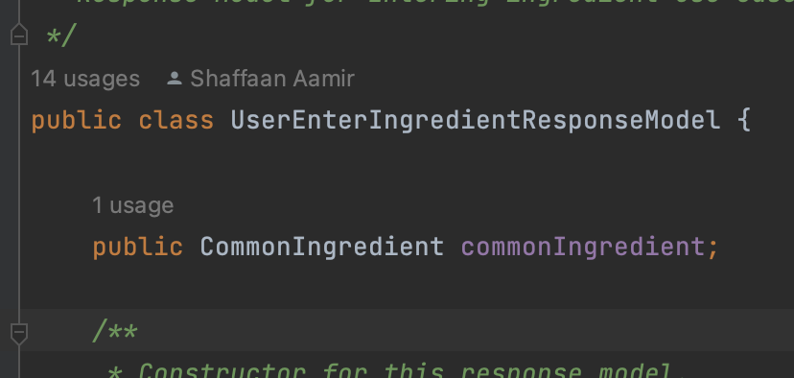
Entering Ingredients

Slide 8
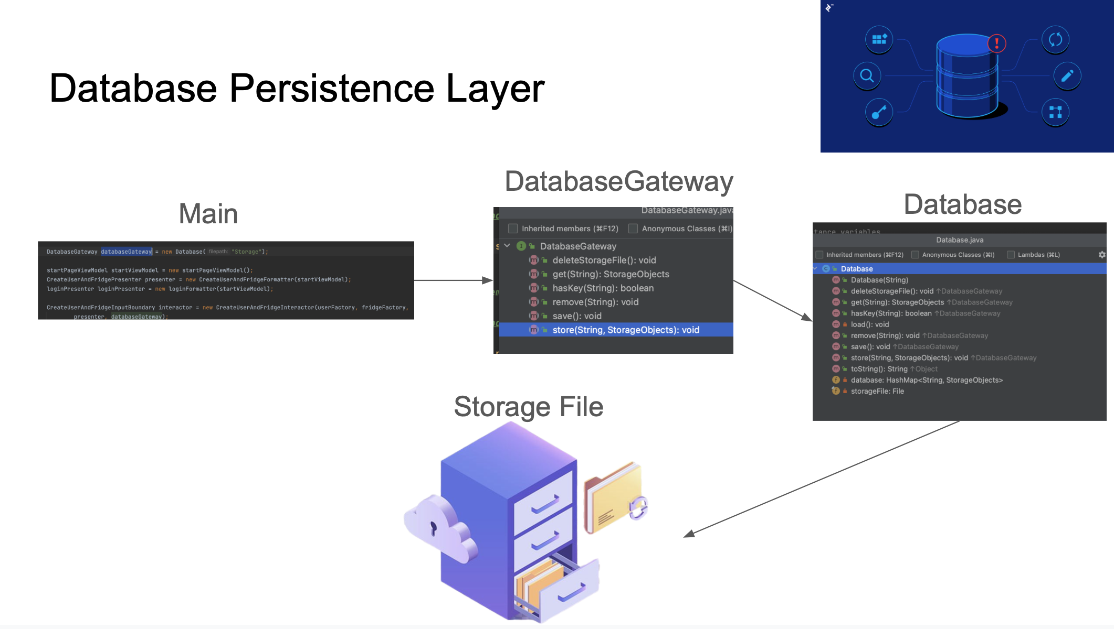

Slide 9
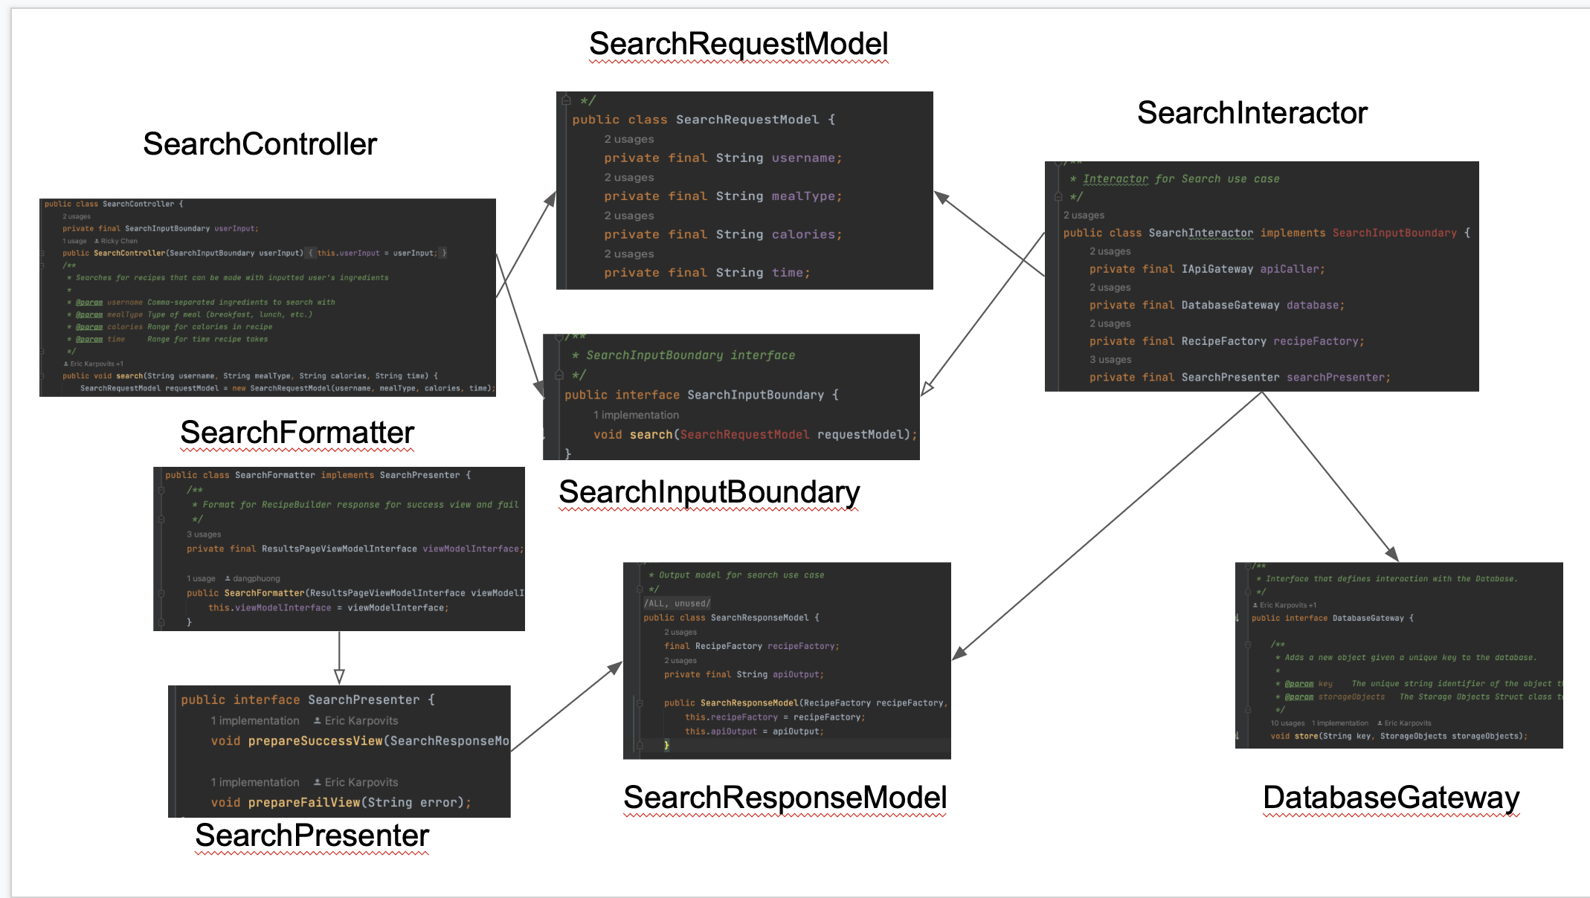

Slide 10
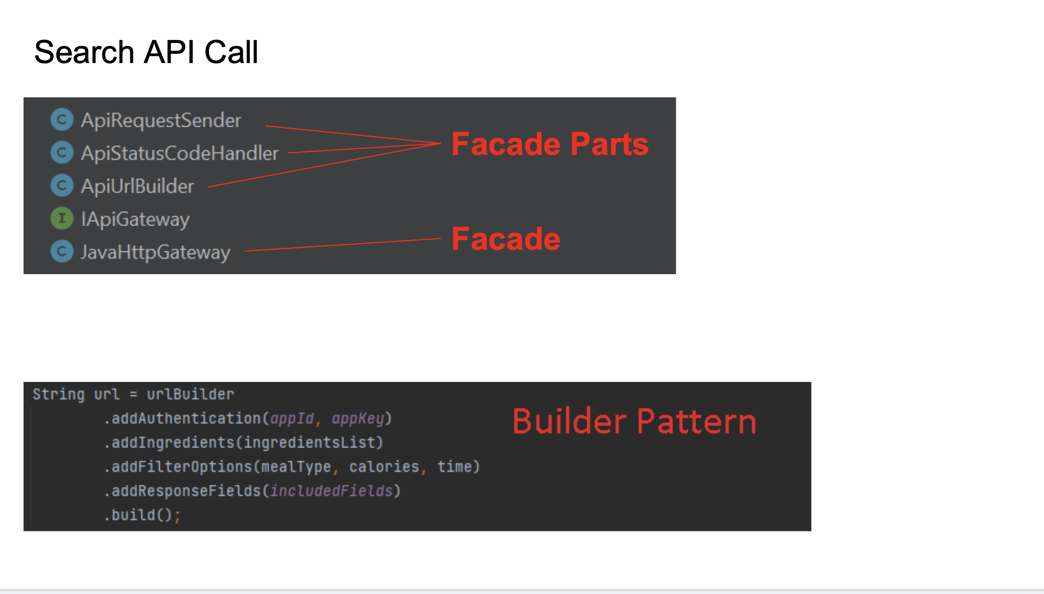

Slide 11
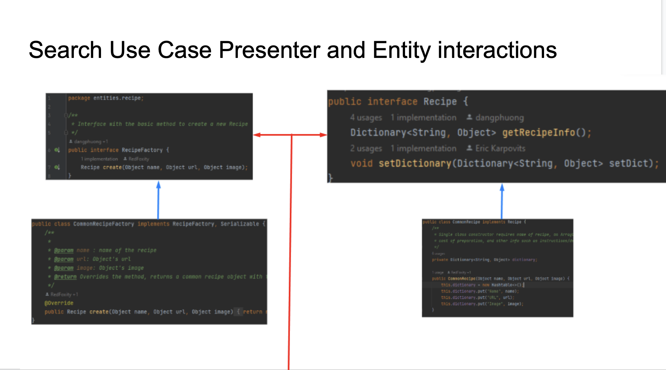

Slide 12
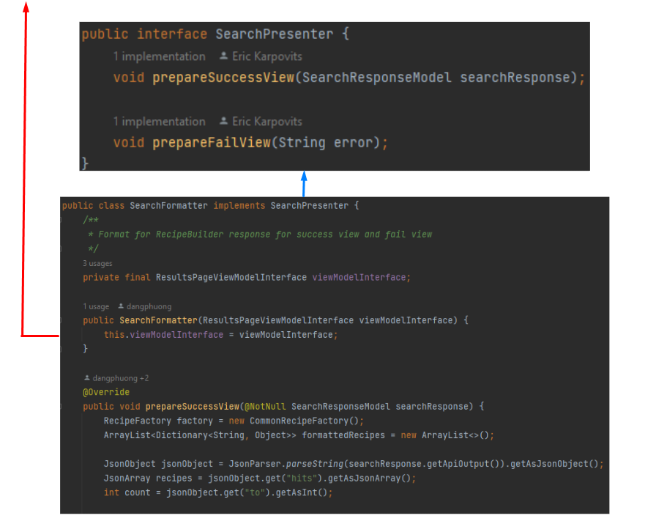

Slide 13
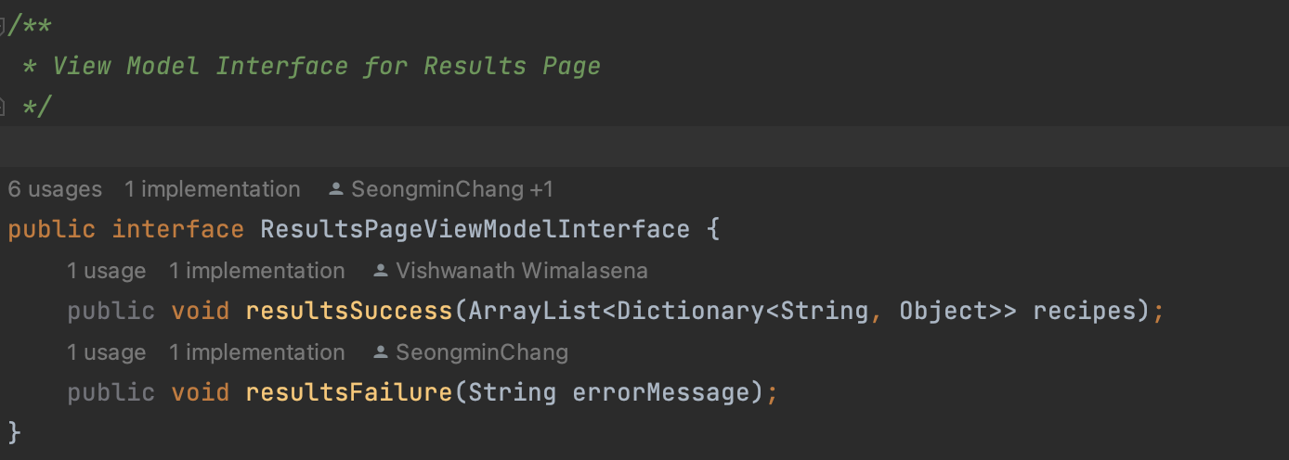
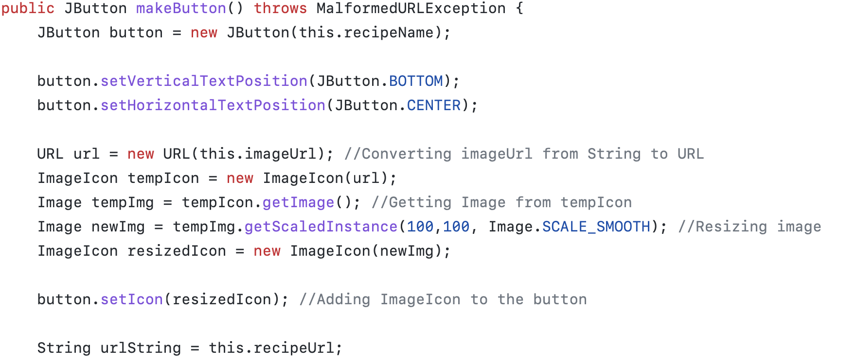
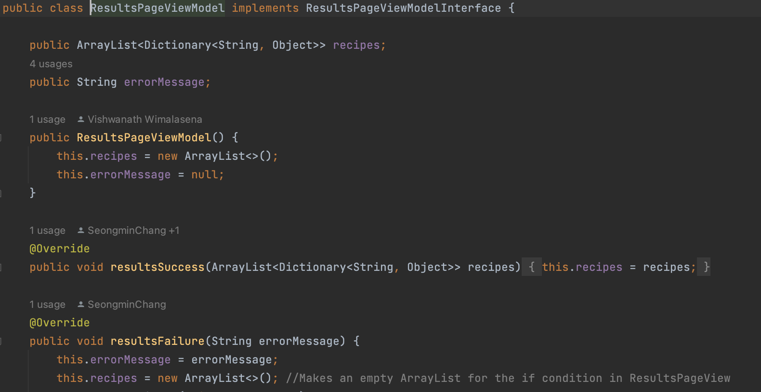
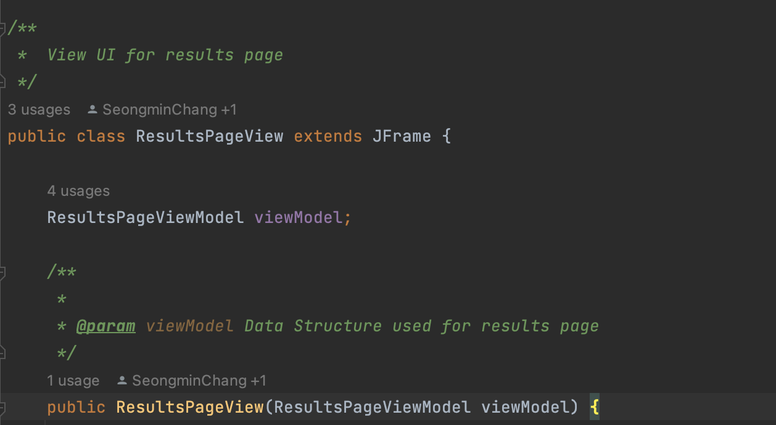
Results Page
Notes:
View Model Interface: Defines the methods the presenter will need to change the data in the view model
Then View Model implements interface and because presenter will update the result, viewmodel will provide data to the view, which is an arraylist of recipes.
One problem I had was the violation of solid principle; since I had to access the keys of recipe, which is a dictionaryasdfnaskjdfhkw

Slide 14
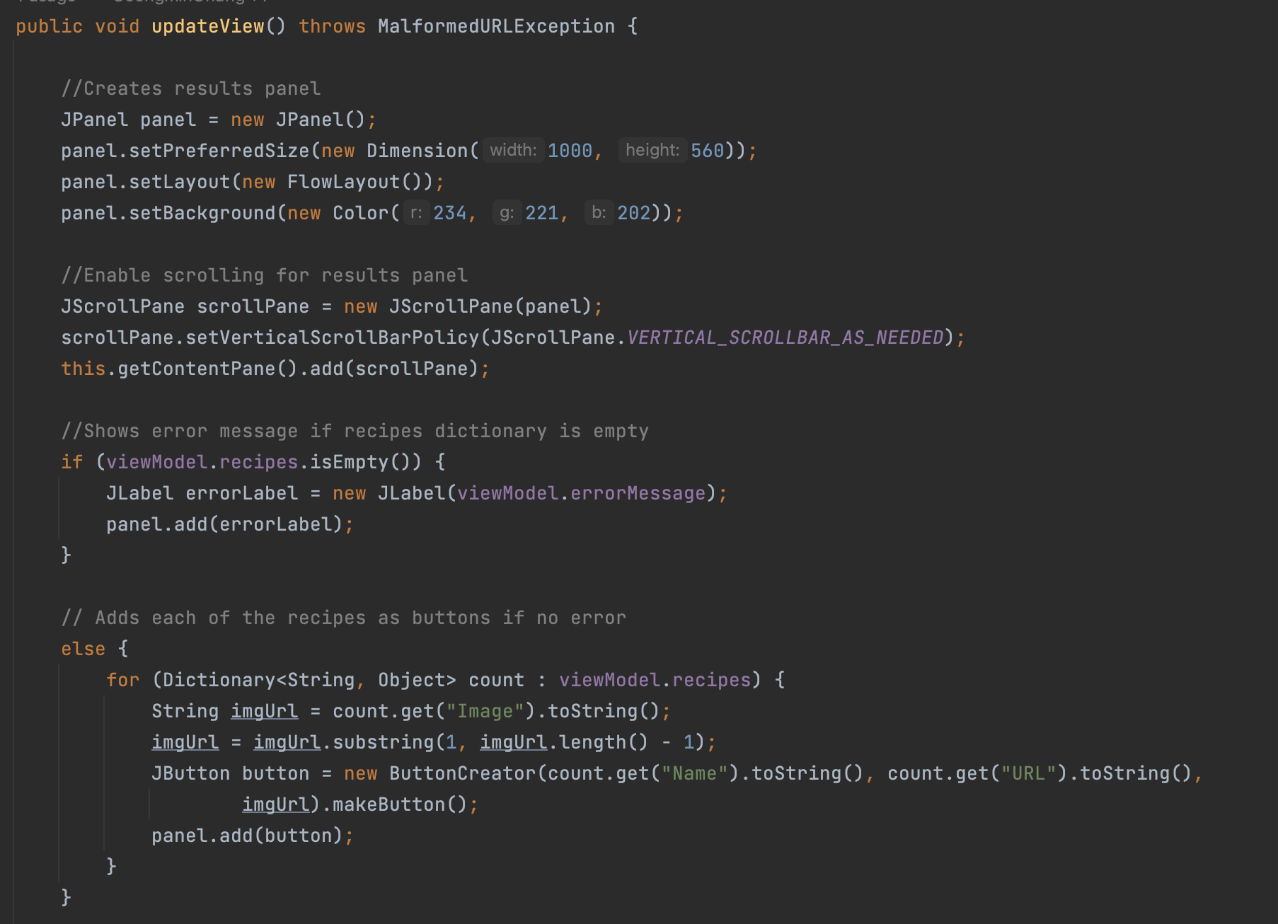
Results Page
Notes:
Swing does not update the view automatically,

Slide 15
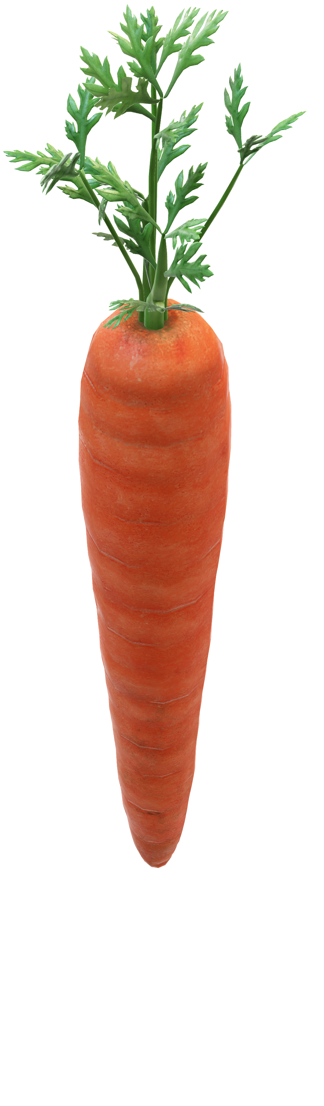
Notes:
Swing does not update the view automatically,

